Slide 1
Canadian Copyright:
An Information Session
Jessica Reeve
Copyright Technician – St. Lawrence College
President OALT/ABO

Slide 2
Disclaimer
This presentation is solely for informational purposes and is not a substitute for legal advice
The opinions expressed in this presentation are those of the presenter and do not necessarily reflect those of her employer
Notes:
Legal disclaimer
Not speaking on behalf of college

Slide 3
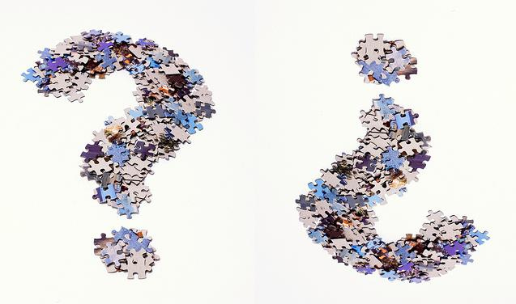
What is copyright?
Statute of Anne 1710
  “An Act for the Encouragement of Learning”
U.S. Constitution
  “To promote the progress of science and useful arts, by securing for limited times to authors and inventors the exclusive right to their respective writings and discoveries”
Rights given to creators
  Sole right to produce and adapt the work
Image by Roland O’Daniel “questions” https://www.flickr.com/photos/rlodan01/4555108439 licensed under CC BY-SA 2.0
Notes:
Copyright = grey area, examples from act of wording i.e. ‘reasonably certain’ ‘insignificant amount’
Risk assesment/aversion
Protection is automatic
Copyright v. trademark
Produce/reproduce substantial portion
(a) to produce, reproduce, perform or publish any translation of the work,
(b) in the case of a dramatic work, to convert it into a novel or other non-dramatic work,
(c) in the case of a novel or other non-dramatic work, or of an artistic work, to convert it into a dramatic work, by way of performance in public or otherwise,
(d) in the case of a literary, dramatic or musical work, to make any sound recording, cinematograph film or other contrivance by means of which the work may be mechanically reproduced or performed,
(e) in the case of any literary, dramatic, musical or artistic work, to reproduce, adapt and publicly present the work as a cinematographic work,
(f) in the case of any literary, dramatic, musical or artistic work, to communicate the work to the public by telecommunication,

Slide 4
What is protected by copyright?
Fixed format
Original work
Skill and judgement
Many different formats
  Literary
  Musical
  Artistic
  Dramatic
  Performance
Facts
Ideas
Notes:
“an original work must be the product of an author’s exercise of skill and judgment” CCH case
‘creativity is not required to make a work “original”’ CCH

Slide 5
Does it ever end?
Public domain
Canada life +50 years
U.S. life +70 years
Publicly Available = Public Domain

Slide 6

A little bit of history
CCH Case
Supreme Court Pentalogy
  Alberta (Education)
  SOCAN v. Bell
  ESA v. SOCAN
  Rogers v. SOCAN
  RE:Sound
Copyright Modernization Act
Access Copyright licenses and the Copyright Board
York v. AC case
Image by Horia Varlan “Large copyright sign made of jigsaw puzzle pieces” https://www.flickr.com/photos/horiavarlan/4839454263/in/photostream/ licensed under CC BY 2.0
Notes:
‘“Research” must be given a large and liberal interpretation in order to ensure that users’ rights are not unduly constrained, and is not limited to non-commercial or private contexts’ CCH reaffirmed in Sony and Alberta (Education)
CCH 2004 – libraries can makes copies for their patrons using the same exceptions the patrons could rely on
Pentalogy 2012 – HANDED DOWN BEFORE CMA PASSED
Alberta (Education) v Access Copyright classroom copies,
copies are evaluated based on the end user i.e. student not on an aggregate scale
teachers acting on behalf of students=ok, just because directed doesn’t mean no ‘private study’
Access Copyright failed to prove market harm as result of copying
SOCAN v Bell 30 sec. samples fair dealing for consumer research (broad interpretation) given streaming and no kept copy
ESA v SOCAN downloading=same as purchasing in store – tech. neutrality=no extra cost no ‘double dipping’ in video games download of game with licensed music not ‘communicating to public via telecommunication’ simply a delivery method tech. neutrality
Rogers v SOCAN streaming is ‘communicating to the public’
Re:Sound v Motion Picture Theatre Association of Canada soundtrack v sound recording when work is licensed as part of a movie soundtrack performers etc are not entitle to remuneration everytime movie is played
CMA Bill C-11 2012

Slide 7
Exceptions
Libraries, Archives and Museums (LAMs)
User-Generated Content “YouTube exception”
Perceptual disabilities
Notes:
LAMs have exceptions allowing for archival copies, interlibrary loan in some circumstances
User-Generated Content – first of its kind in the world, allows for non-commerical mash-up of content
Specific exceptions for perceptual disabilities – does not cover large print books or cinematographic works

Slide 8
Fair dealing
2 step test
  First step : for a purpose stated in the Act
    Research
    Private study
    Criticism
    Review
    News reporting
    Education
    Satire
    Parody
Notes:
Must be given a ‘large and liberal interpretation in order to ensure that users’ rights are not unduly constrained ’ per Supreme Court
Users right but without specific definition’s hard to tell without court case – even then different circumstances may yield different results

Slide 9
2nd step : must be fair
  6 factors to assess
    Purpose
    Amount
      AUCC and ACCC guidelines
        Up to 10% of a work
        One chapter from a book
        Single article from a periodical
        An artistic work from a work containing other artistic works
    Character
    Alternatives
    Nature of the work
    Effect of copying on the work
Notes:
Alternatives – in Canada the option of licensing the work is not considered an alternative

Slide 10
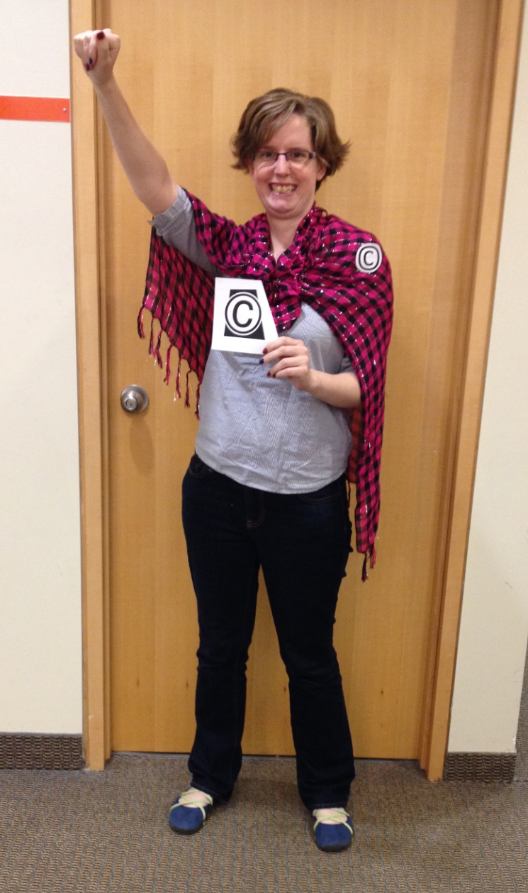
Educational Exceptions
Publicly Available internet Material (PAM)
Performance
Online lessons
Photo by Nadine Gordon, reproduced with permission
Notes:
Educational institutions defined in act
Publicly accessible internet material – not password protected, etc. and must cite source
Performance – can show movies in class for educational purpose as long as it is legal copy – no need for public performance license
Online lessons – allows faculty to record lessons with copyright protected content with certain caveats

Slide 11
TPMs and Technological Neutrality
Technological Protection Measure or Digital Locks
  Password protected
  Regional encryption on DVDs
  Watermarks
Notes:
‘“[t]he principle of technological neutrality requires that, absent evidence of Parliamentary intent to the contrary, we interpret the Copyright Act in a way that avoids imposing an additional layer of protections and fees based solely on the method of delivery of the work to the end user. To do otherwise would effectively impose a gratuitous cost for the use of more efficient, Internet-based technologies” (at para 9)’ ESA v SOCAN
If content is protected by a Digital Lock you can not copy it, only very specific allowances like for perceptual disabilities but even if use is otherwise legal breaking the Digital Lock makes it illegal

Slide 12

Licenses
Not 100% clear what takes precedence

Slide 13
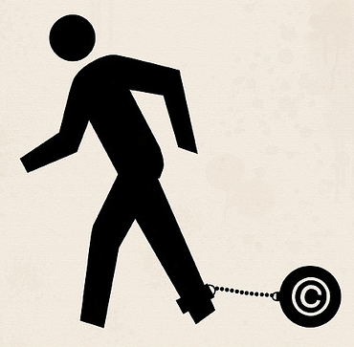
What if it all goes wrong?
$5,000 limit for non-commercial infringement
Image by Cold Storage “Copyright Reform Now [FN03]” https://www.flickr.com/photos/horiavarlan/4839454263/in/photostream/ licensed under CC BY 2.0 image cropped

Slide 14
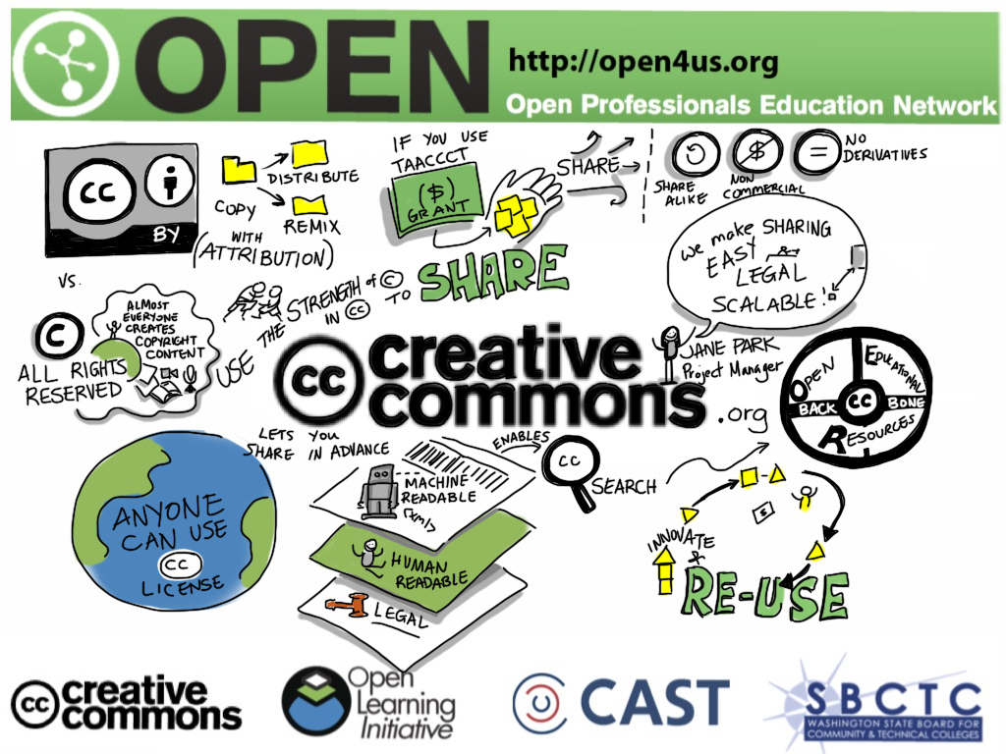
Alternatives
Image by Giulia Forsythe “Using The Strength Of Copyright To Share: @creativecommons #taaaccct #open4us” https://www.flickr.com/photos/gforsythe/9102402492 licensed under CC BY 2.0
Notes:
Copyleft
Creative Commons
different types of licenses, ATTRIBUTION ALWAYS REQUIRED, non commerical, share alike, no derivatives mix and match
Open Access/OER

Slide 15
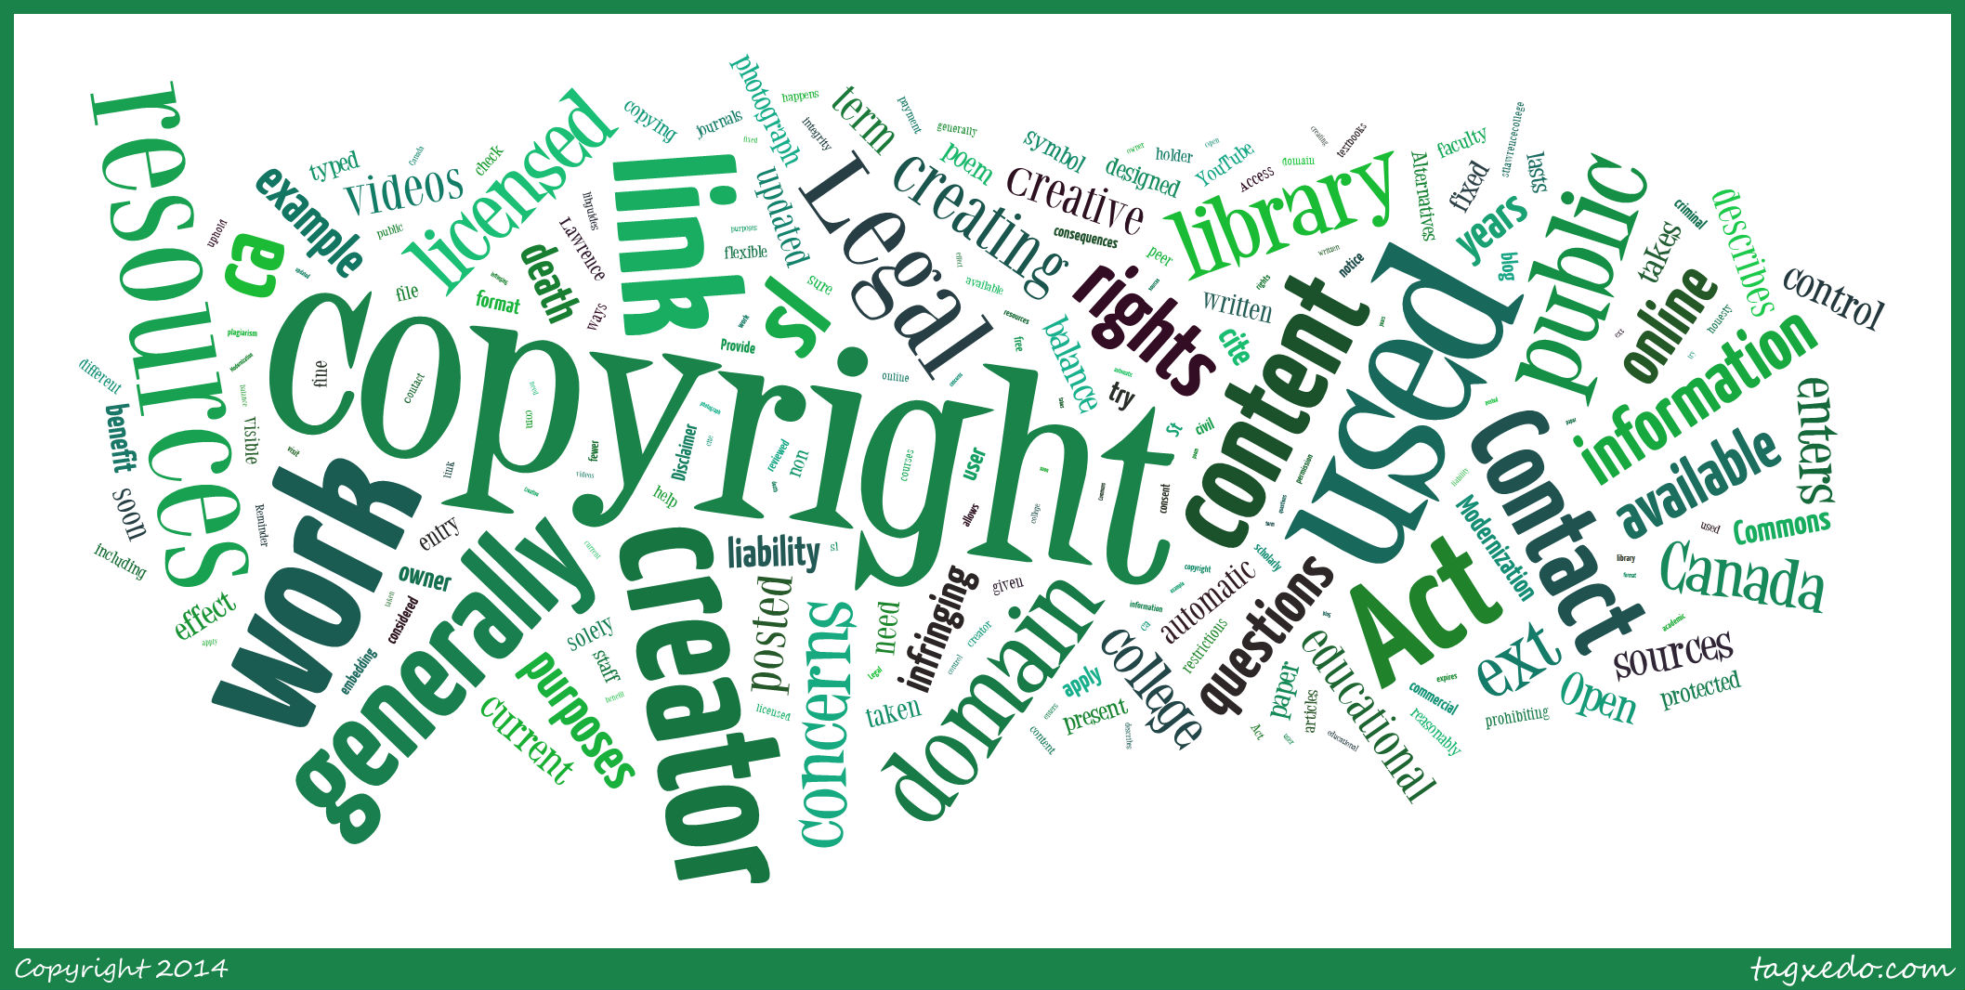
Odds and Ends
Artwork
Picture of a copyright protected work
First sale doctrine
  Owning a copy vs. owning the copyright
Copyright around the world
Permission vs. attribution
Notes:
First sale doctrine – once you purchase a book you can do what you like with that copy i.e. resell it, donate it, etc. but you only own that copy not the right to make more copies of it
There are some international treaties regarding copyright but every country has there own laws
Academic honesty/plagiarism is not the same as copyright

Slide 16
Resources
http://stlawrencecollege.libguides.com/copyright
http://cmec.ca/Publications/Lists/Publications/Attachments/291/Copyright_Matters.pdf
http://www.canlii.org/en/ca/laws/stat/rsc-1985-c-c-42/latest/
http://scc-csc.lexum.com/scc-csc/scc-csc/en/item/2125/index.do
http://scc-csc.lexum.com/scc-csc/scc-csc/en/item/9997/index.do
http://search.creativecommons.org/
http://www.michaelgeist.ca/
http://arielkatz.org/
http://excesscopyright.blogspot.ca/
http://samtrosow.wordpress.com/

Slide 17
Questions?
jessica.reeve@sympatico.ca

